Slide 1
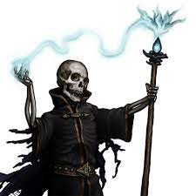
The Night of the Lich
Pitch Date: 12/18/2022 Update 4/2/2023
Release Date: 4/9/2023 228 Commits (+8)
Team Lead: Vince McKeown 14 Contributors
1
2
3
4
5
6
7
8
9
10
11
12
13
14
15
16

Slide 2
Vince McKeown
Added Attack animation for player
Created a Game Over Screen

Slide 3
H Trayford
Player’s thoughts expanded into Graveyard

Slide 4
Christer “McFunkyPants” Kaitila
Amazing Voice over
Fixed Title Screen Index

